Slide 1


PARAÑAQUE SECTOR
CONSTRUCTION TEAM 1
GAINS
GOALS and INITIATIVES
As of July 18, 2025

Slide 2





CONSTRUCTION TEAM 1
ENERGY SALES
CCNI
CSI
LTIFR
SUSTAINABILITY
Customer Connection Timeliness Index (CCTI)
Customer Connection Timeliness Index (CCTI)
WO Cost Settlement to RAB (Mid-Year)
Quality Management Index
Lost Time Incidents
Natural Ester-oil Pole Mounted DTs Installation
SUSTAINABILITY
PCA Conversion Rate
Lost Time Incidents
Completion of Ageing PCAs
Completion of DPWH &
Priority Gov't Reloc Projects
Adherence to approved PAI SAIDI
Fatality
WO Cost Settlement to RAB (Year-End)
Fatality
PCA Termination/ Modification APT
Completion of BBB Reloc Projects
PCA Termination Resolution of Pending PCA
Natural Ester-oil Pole Mounted DTs Installation
Project Resolution Duration Index (PRDI)

Slide 3
2025 C1 GAINS | Paranaque C1
 | GAINS | GAINS | Unit | Weight | Target | Stretch
Energy Sales | OL2 | Customer Connection Timeliness Index (CCTI) | Index | 20% | 1.10 | 1.02
 | OL2 | PCA Conversion Rate | Count | 17% | 93.8% | 95.7%
 | OL3 | Completion of Ageing PCAs | % Completion | 5% | 95% | 100%
 | OL2 | Adherence to approved PAI SAIDI | % adherence | 5% | within ±10% | within ±5%
 | OL3 | PCA Termination/Modification APT | Days | 2% | 40 | 40
 | OL3 | PCA Termination Resolution of Pending PCA | % Completion | 1% | 90.0% | 100.0%
 | OL3 | Project Resolution Duration Index (PRDI) | Index | 5% | 1.00 | 0.95
CAPEX Implementation | OL2 | WO Cost Settlement to RAB (Mid-Year) | % WO Cost | 5% | 3.240 B | 3.300 B
 | OL2 | WO Cost Settlement to RAB (Year-End) | % WO Cost | 5% | 6.470 B | 6.590 B
CSI | OL3 | Quality Management Index | Index | 10% | 90% | 98%
 | OL2 | Completion of DPWH & Priority Gov't Reloc Projects | % Completion | 7% | 95% | 100%
 | OL2 | Completion of BBB Reloc Projects | % Completion | 7% | 95% | 98%
Lost Time Incident Frequency Ratio | OL3 | Lost Time Incidents | Number of Cases | 3.0% | 0 | 0
 | OL3 | Fatality | Number of Cases | 3.0% | 0 | 0
Sustainability | OL1 | Natural Ester-oil Pole Mounted DTs Installation | Units | 5% | 11,000 | 12,000

Slide 4




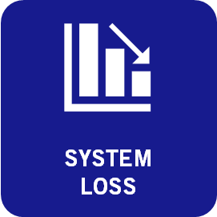



CONSTRUCTION TEAM 1
LEVEL | GAINS | Units | Weight | Target | Stretch | 2024 YE Perf
OL2 | Customer Connection Timeliness Index (CCTI) | Index | 5% | 1.10 | 1.02
OL3 | Customer Connection Timeliness Index (CCTI) | Index | 6% | 1.10 | 1.02
C1 | Customer Connection Timeliness Index (CCTI) | Index | 20% | 1.10 | 1.02 | 1.12
 |  |  |  |  | WITH EXCLUSION
VENDOR | TOTAL PCA COMPLETED | COMPLETED (JULY 12-18, 2025) | CCTI (FCOMP) | CCTI (less than FCOMP) | CCTI (FCOMP) | CCTI (less than FCOMP) | Count of beyond SPT
AVECO | 50 | 2 | 1.51 | 2.73 | 1.47 | 2.73 | 25
CHALLENGER | 69 | 3 | 1.13 | 2.51 | 1.07 | 1.66 | 6
ECOM | 30 | 0 | 1.09 | 2.36 | 1.09 | 2.36 | 17
POWERHOUSE | 47 | 0 | 2.11 | 2.16 | 2.02 | 2.16 | 17
VJC | 74 | 4 | 1.43 | 2.62 | 1.26 | 1.48 | 12
C2 | 15 | 0 | 0.50 | 4.93 | 0.50 | - | 1
MAINTENANCE | 11 | 3 | 1.38 | 0.00 | 1.38 | - | 0
STA. ROSA | 2 | 0 | 0.00 | 0.00 | - | - | 0
TOTAL | 298 | 12 | 1.32 | 2.52 | 1.25 | 2.22 | 78
 |  |  | 1.57 |  | 1.45
ENERGY SALES
Customer Connection Timeliness Index (CCTI)
PCA Conversion Rate
Completion of Ageing PCAs
Adherence to approved PAI SAIDI
CREW | TOTAL MNHRS COMPLETED | COMPLETED (JULY 1-11, 2025)
AVECO | 16,730.75 | 1,163.74
CHALLENGER | 8,107.68 | 213.19
ECOM | 3,129.50 | 38.52
POWERHOUSE | 6,352.93 | 358.19
VJC | 18,146.58 | 128.69
C2 | 351.76 | 63.34
MAINTENANCE | 307.60 | -
STA. ROSA | 725.83 | -
TOTAL | 53,852.63 | 1,965.67
PCA Termination/Modification APT
Scope:
NEW (CC-type)
Latest WMTRL Date and FCOMP Date are in the current year
Latest WMTRL Date is in the current year, not yet FCOMP and is already beyond SPT based on Manhour and Applied Load clusters
PCA Termination Resolution of Pending PCA
Project Resolution Duration Index (PRDI)
Notes:
Action plans:

Slide 5
CCTI
KPI
Connection Construction Timeliness Index (CCTI)
Performing Office
P&S OL3, Scheduler
Sector OL3, Construction 1, Underground
Formula
CCTI = Σ[30% (Project Duration/SPTm)] + Σ[ 70% (Project Duration/SPTr)]
Total Project Count
where: Project Duration = FCOMP Status – WMTRL Status
SPT based on Manhour Cluster
MANHOURS | SPT
0 - 50 | 20.00
51 - 100 | 23.00
101 - 200 | 26.00
201 - 300 | 28.00
301 - 400 | 30.00
401 - 500 | 32.00
501 - 1000 | 36.00
1001 - 1500 | 40.00
1501 - 2000 | 45.00
Above 2000 | 50.00*
 | *or within target date
SPT based on Applied Load Cluster
APPLIED LOAD | SPT
0 - 50 | 36.00
51 - 100 | 34.00
101 - 200 | 32.00
201 - 300 | 30.00
301 - 400 | 28.00
401 - 500 | 26.00
501 - 1000 | 23.00
above 1000 | 20.00

Slide 6
CONSTRUCTION TEAM 1
LEVEL | GAINS | Units | Weight | Target | Stretch | 2024 YE Perf
OL2 | Customer Connection Timeliness Index (CCTI) | Index | 5% | 1.10 | 1.02
OL3 | Customer Connection Timeliness Index (CCTI) | Index | 6% | 1.10 | 1.02
C1 | Customer Connection Timeliness Index (CCTI) | Index | 20% | 1.10 | 1.02 | 1.12
ENERGY SALES
Customer Connection Timeliness Index (CCTI)
Root-cause for Non-attainment: Crew workload, pole location issues, third-party refusal and customer compliance, and insufficient contractual manpower leading to backlogs in PCA execution, causing delays in energization
PCA Conversion Rate
Completion of Ageing PCAs
Adherence to approved PAI SAIDI
Recommended Adjustments (if any): Prioritization of both revenue and non-revenue PCA
PCA Termination/Modification APT
PCA Termination Resolution of Pending PCA
Project Resolution Duration Index (PRDI)
Notes:
Action plans:

Slide 7
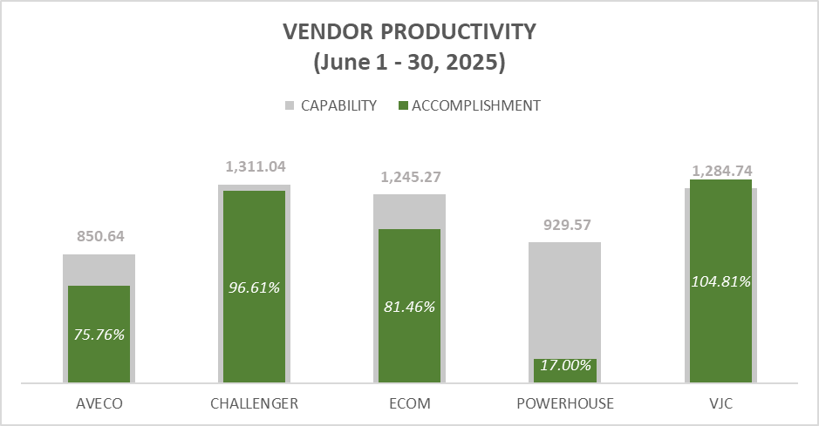
CONSTRUCTION TEAM 1
aasf
LEVEL | GAINS | Units | Weight | Target | Stretch | 2024 YE Perf
OL2 | Customer Connection Timeliness Index (CCTI) | Index | 5% | 1.10 | 1.02
OL3 | Customer Connection Timeliness Index (CCTI) | Index | 6% | 1.10 | 1.02
C1 | Customer Connection Timeliness Index (CCTI) | Index | 20% | 1.10 | 1.02 | 1.12
ENERGY SALES
Customer Connection Timeliness Index (CCTI)
ACCOMPLISHMENT
(ON-SITE MANHOURS)
C1 CREWS: 4,429.99
C2, MN, SRO: 637.88
PCA Conversion Rate
Completion of Ageing PCAs
5,067.87
Adherence to approved PAI SAIDI
PCA Termination/Modification APT
90.16%
PCA Termination Resolution of Pending PCA
Project Resolution Duration Index (PRDI)

Slide 8





CONSTRUCTION TEAM 1
LEVEL | GAINS | Units | Weight | Target | Stretch | 2024 YE Perf
OL2 | Customer Connection Timeliness Index (CCTI) | Index | 5% | 1.10 | 1.02
OL3 | Customer Connection Timeliness Index (CCTI) | Index | 6% | 1.10 | 1.02
C1 | Customer Connection Timeliness Index (CCTI) | Index | 20% | 1.10 | 1.02 | 1.12
ENERGY SALES
Customer Connection Timeliness Index (CCTI)
PCA Conversion Rate
Completion of Ageing PCAs
Adherence to approved PAI SAIDI
PCA Termination/Modification APT
PCA Termination Resolution of Pending PCA
- NO DUTY
- HOLIDAYS
- C2 PAI
- OPS TROUBLE
- ASSIST TO OTHER
SECTORS
- TRUCK TROUBLE
- MAINTENANCE
OTBT
- BACK JOB
CORRECTION
Project Resolution Duration Index (PRDI)

Slide 9
CONSTRUCTION TEAM 1
LEVEL | GAINS | Units | Weight | Target | Stretch | 2024 YE Perf
OL2 | Customer Connection Timeliness Index (CCTI) | Index | 5% | 1.10 | 1.02
OL3 | Customer Connection Timeliness Index (CCTI) | Index | 6% | 1.10 | 1.02
C1 | Customer Connection Timeliness Index (CCTI) | Index | 20% | 1.10 | 1.02 | 1.12
ENERGY SALES
PENDING AS OF JUNE 30, 2025 (WO Released 2025)
 | NEW | MODIFICATION | RELOC | TERMINATION | Grand Total
AVECO | 32 | 5 | 11 | 7 | 55
CHALLENGER | 9 | 5 | 4 | 1 | 19
ECOM | 20 | 7 | 2 | 3 | 32
POWERHOUSE | 24 | 12 | 3 | 5 | 44
VJC | 21 | 5 | 2 |  | 28
C2 | 5 | 1 |  |  | 6
MAINTENANCE | 4 | 2 |  |  | 6
Grand Total | 115 | 37 | 22 | 16 | 190
Customer Connection Timeliness Index (CCTI)
PCA Conversion Rate
Completion of Ageing PCAs
Adherence to approved PAI SAIDI
 | NEW | MODIFICATION | RELOC | TERMINATION | Grand Total
AVECO | 3,905.03 | 595.33 | 3,249.62 | 175.63 | 7,925.61
CHALLENGER | 1,200.05 | 669.61 | 1,286.31 | 7.67 | 3,163.65
ECOM | 2,692.82 | 462.56 | 283.02 | 139.15 | 3,577.54
POWERHOUSE | 2,259.71 | 1,398.49 | 473.88 | 193.80 | 4,325.87
VJC | 2,433.60 | 556.10 | 165.94 |  | 3,155.64
C2 | 139.70 | 12.43 |  |  | 152.13
MAINTENANCE | 578.65 | 42.68 |  |  | 621.33
Grand Total | 13,209.55 | 3,737.20 | 5,458.76 | 516.25 | 22,921.77
PCA Termination/Modification APT
PCA Termination Resolution of Pending PCA
Project Resolution Duration Index (PRDI)

Slide 10
CONSTRUCTION TEAM 1
LEVEL | GAINS | Units | Weight | Target | Stretch | 2024 YE Perf
OL2 | Customer Connection Timeliness Index (CCTI) | Index | 5% | 1.10 | 1.02
OL3 | Customer Connection Timeliness Index (CCTI) | Index | 6% | 1.10 | 1.02
C1 | Customer Connection Timeliness Index (CCTI) | Index | 20% | 1.10 | 1.02 | 1.12
ENERGY SALES
PENDING AS OF JUNE 30, 2025 (WO Released 2025)
 | <100 | 100-500 | >500 | TOTAL
NEW | 71.00 | 41.00 | 3.00 | 115.00
AVECO | 19.00 | 12.00 | 1.00 | 32.00
CHALLENGER | 4.00 | 5.00 | - | 9.00
ECOM | 13.00 | 6.00 | 1.00 | 20.00
POWERHOUSE | 14.00 | 10.00 | - | 24.00
VJC | 14.00 | 6.00 | 1.00 | 21.00
C2 | 5.00 | - | - | 5.00
MAINTENANCE | 2.00 | 2.00 | - | 4.00
MODIFICATION | 25.00 | 11.00 | 1.00 | 37.00
AVECO | 3.00 | 2.00 | - | 5.00
CHALLENGER | 3.00 | 2.00 | - | 5.00
ECOM | 6.00 | 1.00 | - | 7.00
POWERHOUSE | 8.00 | 3.00 | 1.00 | 12.00
VJC | 2.00 | 3.00 | - | 5.00
C2 | 1.00 | - | - | 1.00
MAINTENANCE | 2.00 | - | - | 2.00
RELOC | 12.00 | 7.00 | 3.00 | 22.00
AVECO | 7.00 | 2.00 | 2.00 | 11.00
CHALLENGER | 1.00 | 2.00 | 1.00 | 4.00
ECOM | 1.00 | 1.00 | - | 2.00
POWERHOUSE | 2.00 | 1.00 | - | 3.00
VJC | 1.00 | 1.00 | - | 2.00
TERMINATION | 14.00 | 2.00 | - | 16.00
AVECO | 6.00 | 1.00 | - | 7.00
CHALLENGER | 1.00 | - | - | 1.00
ECOM | 2.00 | 1.00 | - | 3.00
POWERHOUSE | 5.00 | - | - | 5.00
Grand Total | 122.00 | 61.00 | 7.00 | 190.00
Customer Connection Timeliness Index (CCTI)
PCA Conversion Rate
Completion of Ageing PCAs
Adherence to approved PAI SAIDI
PCA Termination/Modification APT
PCA Termination Resolution of Pending PCA
Project Resolution Duration Index (PRDI)

Slide 11
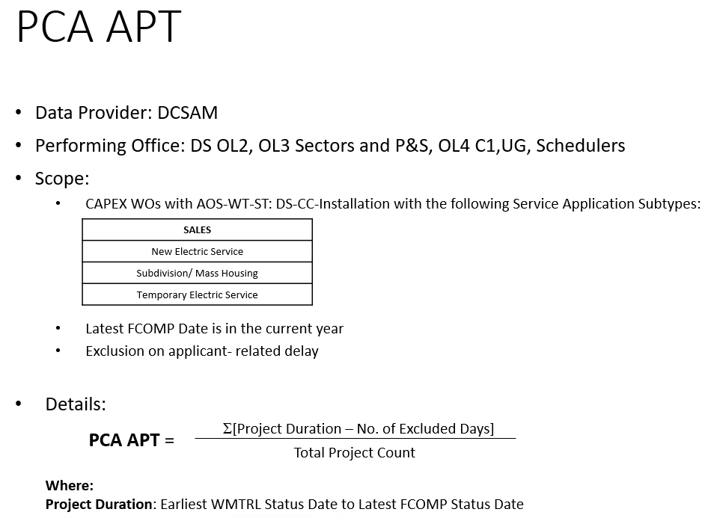
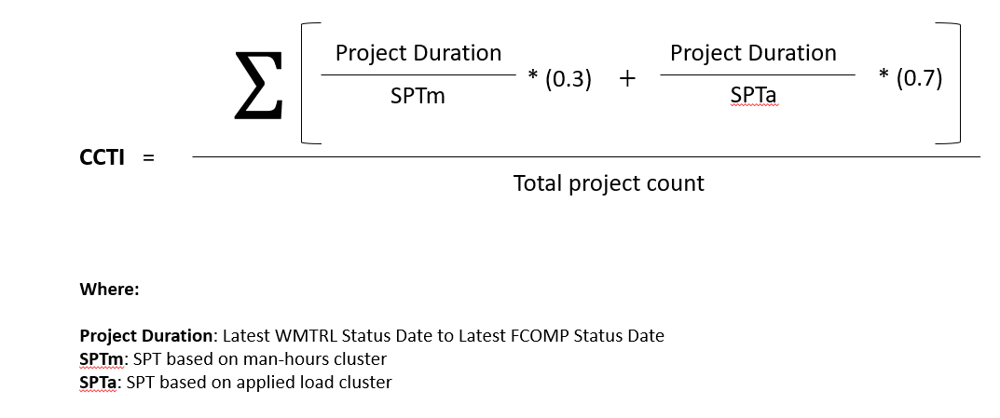
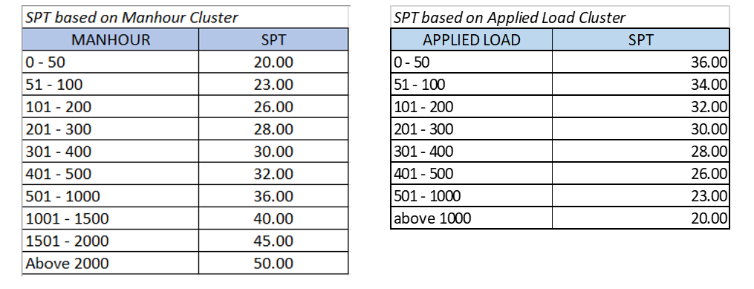
Connection Construction Timeliness Index (CCTI)

Slide 12
CONSTRUCTION TEAM 1
LEVEL | GAINS | Units | Weight | Target | Stretch | 2024 YE Perf
OL2 | PCA Conversion Rate | Days | 5% | 93.83% | 95.69%
OL3 | Customer Connection Timeliness Index (CCTI) | Days | 5% | 94% | 96%
C1 | Customer Connection Timeliness Index (CCTI) | Days | 17% | 93.8% | 95.7% | (new KPI)
ENERGY SALES
YTD ENERGIZED | 277
CARRY-OVER FROM 2024 | 112
FOR CANCELLATION/CANCELLED | 22
WMTRL 2025 | 309
Customer Connection Timeliness Index (CCTI)
PCA Conversion Rate
PCA COUNT INDEX | CONVERSION RATE | PERFORMANCE COMPLETION INDEX
Completed vs Goal | Completed vs Released
90.52% | 69.42% | 77.86%
Completion of Ageing PCAs
Adherence to approved PAI SAIDI
as of June 13– 61.03%
PCA Termination/Modification APT
Scope:
Count of WO from:
previous year carry over
WO received and completed this Dec. 2025 will be added to numerator and denominator.
CAN and PCAN WOs are excluded
PCA Termination Resolution of Pending PCA
Project Resolution Duration Index (PRDI)

Slide 13
CONSTRUCTION TEAM 1
LEVEL | GAINS | Units | Weight | Target | Stretch | 2024 YE Perf
OL2 | PCA Conversion Rate | Days | 5% | 93.83% | 95.69%
OL3 | Customer Connection Timeliness Index (CCTI) | Days | 5% | 94% | 96%
C1 | Customer Connection Timeliness Index (CCTI) | Days | 17% | 93.8% | 95.7% | (new KPI)
ENERGY SALES
Customer Connection Timeliness Index (CCTI)
Root-cause for Non-attainment: Crew workload, pole location issues, third-party refusal and customer compliance, and insufficient contractual manpower leading to backlogs in PCA execution, causing delays in energization
PCA Conversion Rate
Completion of Ageing PCAs
Adherence to approved PAI SAIDI
Recommended Adjustments (if any): PCA assignment to regular crews of C2 and Maintenance
PCA Termination/Modification APT
PCA Termination Resolution of Pending PCA
Project Resolution Duration Index (PRDI)

Slide 14
PCA Conversion Rate
KPI
Conversion Rate
Performing Office
DS OL2/OL3, P&S OL3, C1 & UG OL4, Schedulers
Scope
All CAPEX work orders with Customer Connection work type and Installation subtype (New Electric Service, Subdivision/Mass Housing, Temporary Electric Service)
Formula:
% = Count of Energized DS PCA Sales WOs
x 100%
Total WO Count
Where:
Total WO Count = Carryover WOs (WMTRL during previous years) + WMTRL during current year (Jan. 1 to Nov. 31)
Note: Wos received and completed in December will be included in both numerator and denominator

Slide 15
CONSTRUCTION TEAM 1
LEVEL | Units | Weight | Target | Stretch | 2024 YE Perf
PCA APT/SPT | Days | - | For monitoring | 95.69% | 37.93
PCA Count | Count | - | For monitoring | 96% | 475
ENERGY SALES
Customer Connection Timeliness Index (CCTI)
PCA Conversion Rate
Completion of Ageing PCAs
Adherence to approved PAI SAIDI
PCA Termination/Modification APT
PCA Termination Resolution of Pending PCA
PCA COUNT (REVENUE ONLY) | JAN | FEB | MAR | APR | MAY | JUN | JUL | AUG | SEP | OCT | NOV | DEC | TOTAL
COMPLETED 2024 | 35 | 50 | 33 | 23 | 45 | 45 | 55 | 40 | 40 | 54 | 20 | 35 | 475
COMPLETED 2025 | 44 | 43 | 56 | 32 | 56 | 46 | 0 | 0 | 0 | 0 | 0 | 0 | 244
Project Resolution Duration Index (PRDI)

Slide 16
PCA Count (for monitoring)
KPI
PCA Count
Performing Office
DS OL2
P&S OL3, Scheduler
Sector OL3, Construction 1, Underground
Scope
All DS and STL PCA Sales work orders with Customer Connection work type and Installation subtype
FCOMP Status Date – from January 1 to December 31, 2025, regardless of WMTRL date

Slide 17
CONSTRUCTION TEAM 1
LEVEL | Units | Weight | Target | Stretch | 2024 YE Perf
PCA APT/SPT | Days | - | For monitoring | 95.69% | 37.93
PCA Count | Count | - | For monitoring | 96% | 475
ENERGY SALES
Customer Connection Timeliness Index (CCTI)
CREW | TOTAL PCA COMPLETED | COMPLETED (JUNE 1-30, 2025) | YTD APT | JUNE APT
AVECO | 46 | 5 | 67.69 | 90.49
CHALLENGER | 64 | 7 | 44.33 | 59.55
ECOM | 29 | 4 | 50.57 | 49.40
POWERHOUSE | 45 | 6 | 76.57 | 97.44
VJC | 66 | 14 | 61.20 | 90.88
C2 | 11 | 4 | 13.73 | 14.47
MAINTENANCE | 8 | 4 | 43.41 | 36.93
STA. ROSA | 2 | 1 | 198.65 | 196.97
TOTAL | 271 | 45 | 58.29 | 73.92
PCA Conversion Rate
Completion of Ageing PCAs
Adherence to approved PAI SAIDI
PCA Termination/Modification APT
PCA Termination Resolution of Pending PCA
Project Resolution Duration Index (PRDI)

Slide 18
PCA APT (for monitoring)
KPI
PCA APT
Performing Office
DS OL2
P&S OL3, Scheduler
DS OL3, Construction 1, Underground
Scope
All DS PCA Sales work orders with Customer Connection work type and Installation subtype based on PCA Application types:
FCOMP Status Date – from January 1 to December 31, 2025, regardless of WMTRL date

Slide 19
PCA APT (for monitoring)
Formula
Design PT = Σ[Earliest DPRG-PCR - Earliest WAPPR + Transfer of Days from Other Milestones – Excluded Days]
Total Project Count
PROW PT = Σ[Latest DCOMP - Earliest DAPPR + Transfer of Days from Other Milestones – Excluded Days]
Total Project Count
Release to Construction PT = Σ[Earliest WMTRL - Earliest AUTHZD + Transfer of Days from Other Milestones – Excluded Days]
Total Project Count
Construction PT = Σ[Latest FCOMP - Earliest WMTRL + Transfer of Days from Other Milestones – Excluded Days]
Total Project Count
Networks End- to- End APT = Design APT + PROW APT + Release to Construction APT + Construction APT

Slide 20
CONSTRUCTION TEAM 1
GAINS | Units | Weight | Target | Stretch | YE Perf
Completion of Ageing PCAs | % Completion | 5% | 95% | 100% | 84%
ENERGY SALES
COMPLETED
(June 1-30, 2025)
Customer Connection Timeliness Index (CCTI)
TYPE | WO | MHRS
REV | 8 | 300.84
NON-REV | 5 | 993.53
WORK ORDER | DESCRIPTION | ASSIGNED CREW | TYPE
X25041438275 | GLOBE TELECOM INC. | ECOM | NEW
X25051872111 | MARIA CRISTINA JOSE VENADAS | MAINTENANCE | MODIFICATION
X25020395161 | JOSE CARLO CHANG MARQUEZ | MAINTENANCE | NEW
X25041438549 | ROSELLER SYGENCO PIERAZ | C2 | NEW
X25041167587 | CITY GOVERNMENT OF PARAÑAQUE | C2 | NEW
X25030785870 | 8TERNITY, INC. | MAINTENANCE | NEW
X25051592853 | CLEMENTE CAPITULO DOMINGO III | MAINTENANCE | MODIFICATION
X25051521575 | PLATINUM PETROLEUM CORP. | C2 | NEW
X25041378549 | RAHUL DEVIDAS DARYANI | VJC | TERMINATION
X25041097966 | ROMAN CATHOLIC BISHOP OF PARANAQUE | ECOM | MODIFICATION
X25041175709 | THE ROMAN CATHOLIC BISHOP OF PARANAQUE, INC. | MAINTENANCE | NEW
X25030797111 | CITY GOVERNMENT OF TAGUIG | C2 | NEW
R24098951 | CAVITEX INFRASTRUCTURE CORP., CBG | ECOM | RELOC
PCA Conversion Rate
Completion of Ageing PCAs
Adherence to approved PAI SAIDI
COMPLETION OF AGEING PCA
80.36%
PCA Termination/Modification APT
PCA Termination Resolution of Pending PCA
Project Resolution Duration Index (PRDI)

Slide 21

CONSTRUCTION TEAM 1
GAINS | Units | Weight | Target | Stretch | YE Perf
Completion of Ageing PCAs | % Completion | 5% | 95% | 100% | 84%
ENERGY SALES
2024 & PRIOR WORK ORDERS
EAM STATUS | 2023 | 2024
CAN | 0 | 2
CLOSED-CAN | 0 | 10
COMP-CAN | 0 | 2
PCAN3 | 0 | 0
PCAN3 | 5 | 3
WO | CREW | WMTRL DATE | EAM STATUS
X21104486609 | VJC | 11/18/2021 | PCAN3 | pending
X21030949643 | ECOM | 11/24/2021 | PCAN | pending
X22052042329 | VJC | 8/23/2022 | PCAN3 | pending
R21956925 | ECOM | 12/9/2022 | PCAN4 | pending
X22125127907 | AVECO | 12/21/2022 | PCAN | pending
X22104175107 | AVECO | 4/3/2023 | PCAN3 | pending
X23072866920 | ECOM | 8/10/2023 | PCAN | pending
X23072873118 | ECOM | 9/26/2023 | PCAN3 | pending
X23010135604 | AVECO | 11/23/2023 | PCAN3 | pending
X23010135483 | AVECO | 11/23/2023 | PCAN3 | pending
X22114994258 | ECOM | 11/29/2023 | PCAN3 | pending
X23114600974 | AVECO | 5/9/2024 | PCAN3 | pending
X24051549285 | ECOM | 5/30/2024 | PCAN3 | pending
R23605089 | ECOM | 11/12/2024 | PCAN3 | pending
X24062437670 | POWERHOUSE | 12/13/2024 | PCAN3 | pending
Customer Connection Timeliness Index (CCTI)
PCA Conversion Rate
Completion of Ageing PCAs
Adherence to approved PAI SAIDI
COMPLETION OF PENDING FOR CANCELLATION
82.35%
PCA Termination/Modification APT
PCA Termination Resolution of Pending PCA
Project Resolution Duration Index (PRDI)

Slide 22
CONSTRUCTION TEAM 1
GAINS | Units | Weight | Target | Stretch | YE Perf
Completion of Ageing PCAs | % Completion | 5% | 95% | 100% | 84%
ENERGY SALES
SUMMARY: PENDING OH
CLEAN-UP AGEING WOs
 | COUNT | AGEING (2024 & PRIOR) | RELEASED 2025 |  | TOTAL
 |  |  | > 90 DAYS | 0-90 DAYS
 | REVENUE | 22 | 25 | 91 | 138
 | NON-REVENUE | 54 | 28 | 42 | 124
 | TOTAL | 76 | 53 | 133 | 262
 | MHRS | AGEING (2024 & PRIOR) | RELEASED 2025 |  | TOTAL
 |  |  | > 90 DAYS | 0-90 DAYS
 | REVENUE | 4,166.74 | 3,327.63 | 9,881.93 | 17,376.29
 | NON-REVENUE | 7,102.15 | 2,316.45 | 4,178.87 | 13,597.47
 | TOTAL | 11,268.88 | 5,644.08 | 14,060.80 | 30,973.76
Customer Connection Timeliness Index (CCTI)
PCA Conversion Rate
Completion of Ageing PCAs
Adherence to approved PAI SAIDI
PCA Termination/Modification APT
PCA Termination Resolution of Pending PCA
Project Resolution Duration Index (PRDI)

Slide 23
CONSTRUCTION TEAM 1
GAINS | Units | Weight | Target | Stretch | YE Perf
Completion of Ageing PCAs | % Completion | 5% | 95% | 100% | 84%
ENERGY SALES
Customer Connection Timeliness Index (CCTI)
Root-cause for Non-attainment: Crew workload, pole location issues, third-party refusal and customer compliance, and insufficient contractual manpower leading to backlogs in PCA execution, causing delays in energization
PCA Conversion Rate
Completion of Ageing PCAs
Adherence to approved PAI SAIDI
Recommended Adjustments (if any): PCA assignment to regular crews of C2 and Maintenance
PCA Termination/Modification APT
PCA Termination Resolution of Pending PCA
Project Resolution Duration Index (PRDI)

Slide 24
Completion of Ageing PCAs
KPI
Completion of Ageing PCAs
Performing Office
Construction 1, Underground
Scope
All work orders with Customer Connection work type and installation subtype based on PCA Application types:
WMTRL prior January 1, 2025
Not yet FCOMPed and beyond SPT
Formula:
% = Count of FCOMPed Ageing PCA
x 100%
Formula
Total Ageing PCA Count

Slide 25
CONSTRUCTION TEAM 1
GAINS | Units | Weight | Target | Stretch | YE Perf
Adherence to approved PAI SAIDI | % adherence | 5% | within ±10% | within ±5% | -3.6%
ENERGY SALES
WORK REQUEST | CIRCUIT | TYPE | MOMENTARY/ STRAIGHT TIME | CUST. AFFECTED | DATE OF EXECUTION | DE-ENERGIZATION | ENERGIZATION | DURATION | SYSTEM SAIDI | CUSTOMER AFFECTED | DATE OF EXECUTION | DE-ENERGIZATION | ENERGIZATION | DURATION | SYSTEM SAIDI | RELATED INC | ADHERENCE
WR 1219028085 | 426WX | CA | Straight | 2,096 | 1/24/25 | 10:00 AM | 1:00 PM | 180 | 0.04716 | 2,096 | 1/24/25 | 10:04 AM | 1:01 PM | 177 | 0.04620 | INC 11272970263 | -2%
WR 1219028259 | 425WU | Gov't | Straight | 801 | 1/28/25 | 10:00 PM | 3:00 AM | 300 | 0.02996 | 801 | 1/28/25 | 10:05 PM | 3:02 AM | 297 | 0.02963 | INC 11272976589 | -1%
WR 1220026968 | 421WG | Gov't | Straight | 530 | 3/13/25 | 11:00 PM | 4:00 AM | 300 | 0.01977 | 526 | 3/13/25 | 11:10 PM | 4:50 AM | 340 | 0.01897 | INC 11273044152 | -4%
WR 1220027001 | 55GG | CA | Straight | 252 | 3/18/25 | 9:00 AM | 1:00 PM | 240 | 0.00753 | 252 | 3/18/25 | 9:06 AM | 1:02 PM | 236 | 0.00739 | INC 11273050822 | -2%
WR 1220027021 | 426WX | CA | Straight | 581 | 3/18/25 | 11:00 PM | 3:00 AM | 240 | 0.01737 | 580 | 3/18/25 | 11:19 PM | 3:48 AM | 269 | 0.01644 | INC 11273051829 | -5%
WR 1220026814 | 415WX | CA | Straight | 1,309 | 3/20/25 | 1:00 AM | 6:00 AM | 300 | 0.04897 | 1,309 | 3/21/25 | 1:00 AM | 5:14 AM | 254 | 0.04243 | INC 11273055145 | -13%
WR 1219030026 | 57GG, 425FIL | CA | Straight | 7,183 | 4/5/25 | 12:30 AM | 5:30 AM | 300 | 0.05856 | 7,149 | 4/5/25 | 1:34 AM | 7:35 AM | 361 | 0.05402 | INC 11273079281 | -8%
WR 1219030285 | 425WU | Gov't | Straight | 7,610 | 4/10/25 | 11:00 PM | 4:00 AM | 300 | 0.13266 | 8,007 | 4/10/25 | 11:14 PM | 4:24 AM | 310 | 0.09508 | INC 11273089570 | -28%
WR 1219030366 | 47XD | CA | Straight | 178 | 4/15/25 | 9:00 AM | 1:00 PM | 240 | 0.00533 | 178 | 4/15/25 | 9:04 AM | 1:00 PM | 236 | 0.00521 | INC 11273100503 | -2%
WR 1219031005 | 47ZJ, 416VX | CA | Straight | 3,355 | 5/1/2025 | 8:00 AM | 1:00 PM | 300 | 0.12703 |  |  |  |  |  | 0.12359 | INC 11273134414 | -3%
WR 1219031198 | 47GG | CA | Straight | 1,613 | 5/9/2025 | 10:00 AM | 3:00 PM | 300 | 0.06004 | 1,613 | 5/9/25 | 10:03 AM | 3:19 PM | 316 | 0.06312 | INC 11273153238 | 5%
 |  |  |  |  |  |  |  |  |  |  |  |  |  |  |  | Total | -7%
Jen | 5
Ronnie | 5
Isan | 1
Customer Connection Timeliness Index (CCTI)
PCA Conversion Rate
Completion of Ageing PCAs
Adherence to approved PAI SAIDI
PCA Termination/Modification APT
PCA Termination Resolution of Pending PCA
Project Resolution Duration Index (PRDI)
ADHERENCE C1 5-20-25.xlsx

Slide 26
CONSTRUCTION TEAM 1
GAINS | Units | Weight | Target | Stretch | YE Perf
PCA Termination/Modification APT | Days | 2% | 40 | 40 | New KPI
ENERGY SALES
Scope:
2024/2025 Created WOs (WAPPR) routed to FCOMP
PCA Modification with AOS-WT-ST:
DS-CC-Installation with the following Service Application Subtypes: Modification of Electric Service, Transfer of Service, Relocation/Remodel
PCA Termination with AOS-WT-ST:
DS-CC-Retirement
FCOMP Date is in the current year
Customer Connection Timeliness Index (CCTI)
TYPE | WO COUNT | AVERAGE PROCESSING TIME
Modification of Electric Service | 78 | 95
Termination of Electric Service | 27 | 78
Grand Total | 105
PCA Conversion Rate
Completion of Ageing PCAs
Adherence to approved PAI SAIDI
TOTAL APT
86 DAYS
PCA Termination/Modification APT
PCA Termination Resolution of Pending PCA
Project Resolution Duration Index (PRDI)

Slide 27
CONSTRUCTION TEAM 1
GAINS | Units | Weight | Target | Stretch | YE Perf
PCA Termination/Modification APT | Days | 2% | 40 | 40 | New KPI
ENERGY SALES
Customer Connection Timeliness Index (CCTI)
Root-cause for Non-attainment: Deprioritized to execute revenue work orders due to workload issues
PCA Conversion Rate
Completion of Ageing PCAs
Adherence to approved PAI SAIDI
Recommended Adjustments (if any): Prioritization of WOs
PCA Termination/Modification APT
PCA Termination Resolution of Pending PCA
Project Resolution Duration Index (PRDI)

Slide 28
CONSTRUCTION TEAM 1
GAINS | Units | Weight | Target | Stretch | YE Perf
PCA Termination Resolution of Pending PCA | % Completion | 1% | 90.0% | 100.0% | New KPI
ENERGY SALES
Scope:
2023 and prior WAPPR Year pending WOs
PCA Termination with AOS-WT-ST:
DS-CC-Retirement
Pending Status = WMTRL, APPR, INPRG, SCHED
 | Pending
PARANAQUE | 2
Customer Connection Timeliness Index (CCTI)
PCA Conversion Rate
WONUM | DESCRIPTION | WMTRL DATE
X23104085941 | PCA, Termination of Electric Service, SME, D.L. CERVANTES CONSTRUCTION CORPORATION | 10/29/2023
X21094255140 | PCA, Termination of Electric Service, BAYPRIME PROPERTIES INC. | 10/27/2021
Completion of Ageing PCAs
Adherence to approved PAI SAIDI
PCA Termination/Modification APT
% RESOLUTION
50%
PCA Termination Resolution of Pending PCA
Project Resolution Duration Index (PRDI)

Slide 29
CONSTRUCTION TEAM 1
GAINS | Units | Weight | Target | Stretch | YE Perf
PCA Termination Resolution of Pending PCA | % Completion | 1% | 90.0% | 100.0% | New KPI
ENERGY SALES
Customer Connection Timeliness Index (CCTI)
Root-cause for Non-attainment: Deprioritized to execute revenue work orders due to workload issues
PCA Conversion Rate
Completion of Ageing PCAs
Adherence to approved PAI SAIDI
Recommended Adjustments (if any): Prioritization of WOs
PCA Termination/Modification APT
PCA Termination Resolution of Pending PCA
Project Resolution Duration Index (PRDI)

Slide 30
Completion of Ageing PCAs
KPI
Completion of Ageing PCAs
Performing Office
Construction 1, Underground
Scope
All work orders with Customer Connection work type and installation subtype based on PCA Application types:
WMTRL prior January 1, 2025
Not yet FCOMPed and beyond SPT
Formula:
% = Count of FCOMPed Ageing PCA
x 100%
Formula
Total Ageing PCA Count

Slide 31
PCA Modification APT (IMOVE)
KPI
PCA Modification APT
Performing Office
DS OL3, Construction 1, Underground, Scheduler
Scope
All work orders with Customer Connection work type and installation subtype.
2024-2025 created WOs (WAPPR) and routed to FCOMP 2025
Based on PCA Application types:
  Modification of Electric Service
  Relocation/Remodel
  Transfer of Service
Formula:
APT = Σ[Latest FCOMP - Earliest WMTRL + Transfer of Days from Other Milestones – Excluded Days]
Total Project Count

Slide 32
PCA Modification APT (IMOVE)
KPI
PCA Retirement APT
Performing Office
DS OL3, Construction 1, Underground, Scheduler
Scope
All work orders with Customer Connection work type and retirement subtype.
2024-2025 created WOs (WAPPR) and routed to FCOMP 2025
Formula:
APT = Σ[Latest FCOMP - Earliest WMTRL + Transfer of Days from Other Milestones – Excluded Days]
Total Project Count

Slide 33
PCA Termination Resolution of Pending PCA
KPI
PCA Termination Resolution of Pending PCA
Performing Office
Construction 1, Underground, Scheduler
Scope
All work orders with Customer Connection work type and retirement subtype.
2023 and prior WAPPR Year pending WOs
Pending Status = WMTRL, APPR, INPRG, SCHED
Formula:
% = Count of FCOMPed Ageing PCA
x 100%
Total Ageing PCA Count

Slide 34
CONSTRUCTION TEAM 1
GAINS | Units | Weight | Target | Stretch | YE Perf
Project Resolution Duration Index (PRDI) | Index | 5% | 1.00 | 0.95 | 3.29
ENERGY SALES
 | 172
PRDI | 149 | 23 | <--- WO COUNT
CREW | PRDI (not yet COMP, beyond SPT) | PRDI (COMP) | COMP WORK ORDERS
AVECO | 1.91 | 1.40 | 3
CHALLENGER | 2.12 | 1.50 | 7
ECOM | 2.01 | 1.61 | 1
POWERHOUSE | 2.14 | 1.61 | 1
VJC | 1.89 | 1.35 | 4
C2 | 2.20 | 1.40 | 6
MAINTENANCE | 1.58 | 0.77 | 1
TOTAL | 2.01 | 1.44 | 23
 | 1.93
Customer Connection Timeliness Index (CCTI)
PCA Conversion Rate
Scope:
FCOMP Date and COMP Date are in the current year
FCOMP Date is in the current year, not yet COMP and is already beyond the SPT (60 days)
Category: NEW (CC-type)
Completion of Ageing PCAs
Adherence to approved PAI SAIDI
PCA Termination/Modification APT
PCA Termination Resolution of Pending PCA
Project Resolution Duration Index (PRDI)

Slide 35
CONSTRUCTION TEAM 1
GAINS | Units | Weight | Target | Stretch | YE Perf
Project Resolution Duration Index (PRDI) | Index | 5% | 1.00 | 0.95 | 3.29
ENERGY SALES
Customer Connection Timeliness Index (CCTI)
Root-cause for Non-attainment: Existing Quality Inspector are still coping up with the pending and increasing volume of work orders for audit
PCA Conversion Rate
Completion of Ageing PCAs
Adherence to approved PAI SAIDI
Recommended Adjustments (if any): Distribution of PCA work orders to other teams. Foreman also assist in quality audit
PCA Termination/Modification APT
PCA Termination Resolution of Pending PCA
Project Resolution Duration Index (PRDI)

Slide 36
PRDI
KPI
Project Resolution Duration Index (PRDI)
Performing Office
DS OL3
Construction 1, Underground
Scope
All CAPEX work orders with Customer Connection work type and Installation subtype
FCOMP Status – from January 1 to December 31, 2025
Ageing WOs – WOs with status below COMP but are already beyond the set SPT based on Manhour cluster
Formula:
PRDI = Σ[(Project Duration/SPT)]
Total Project Count
where: Project Duration = COMP Status – FCOMP Status
*SPT is 60 days

Slide 37

Project Resolution Duration Index (PRDI)
Data Provider: DCSAM
Performing Office: OL4 C1, UG
Scope:
  CAPEX WOs with AOS-WT-ST: DS-CC-Installation with the following Service Application Subtypes:
  FCOMP Date and COMP Date are in the current year
  FCOMP Date is in the current year, not yet COMP and is already beyond the SPT
Details:
SALES
New Electric Service
Subdivision/ Mass Housing
Temporary Electric Service
$$Σ$$
Project Duration
SPT
Where:
Project Duration = FCOMP Status Date to COMP Status Date
SPT = 60 days
PRDI =
Total project count

Slide 38
CONSTRUCTION TEAM 1
LEVEL | GAINS | Units | Weight | Target | Stretch | 2024 YE Perf
OL2 | WO Cost Settlement to RAB (Mid-Year) | WO Cost (in Billion Php) | 2.5% | 3.240 B | 3.300 B
OL3 | Customer Connection Timeliness Index (CCTI) | WO Cost (in Php) | 2.5% | 3.240 B | 3.300 B
C1 | Customer Connection Timeliness Index (CCTI) | % WO Cost | 5% | 3.240 B | 3.300 B | 1.12
CCNI
WO Cost Settlement to RAB (Mid-Year)
Supervisor | PENDING |  | COMP |  | TECO/CLOSED |  | (Comp + Closed) / (Pending+Comp+Teco)
ISAN CARLO LAZARO | 675 | 76,528,621.02 | 27 | 6,191,469.63 | 10 | 3,250,807.29 | 11%
JENNETH MADRID | 247 | 72,791,089.63 |  |  | 7 | 1,487,541.79 | 2%
RONILO JR GANGE | 674 | 116,892,097.94 | 11 | 2,077,911.33 | 52 | 15,720,366.13 | 13%
Grand Total | 1,596 | 266,211,808.59 | 38 | 8,269,380.96 | 69 | 20,458,715.21 | 10%
WO Cost Settlement to RAB (Year-End)

Slide 39
CONSTRUCTION TEAM 1
LEVEL | GAINS | Units | Weight | Target | Stretch | 2024 YE Perf
OL2 | WO Cost Settlement to RAB (Mid-Year) | WO Cost (in Billion Php) | 2.5% | 6.470 B | 6.590 B
OL3 | Customer Connection Timeliness Index (CCTI) | WO Cost (in Php) | 2.5% | 6.470 B | 6.590 B
C1 | Customer Connection Timeliness Index (CCTI) | % WO Cost | 5% | 6.470 B | 6.590 B | 1.12
CCNI
WO Cost Settlement to RAB (Mid-Year)
NO DATA YET
WO Cost Settlement to RAB (Year-End)

Slide 40
CONSTRUCTION TEAM 1
LEVEL | GAINS | Units | Weight | Target | Stretch | 2024 YE Perf
OL3 | Quality Management Index | Index | 4% | 90% | 98%
C1 | Quality Management Index | Index | 10% | 90% | 98% | 92%
CSI
Quality Management Index
NO DATA YET
Completion of DPWH &
Priority Gov't Reloc Projects
Completion of BBB Reloc Projects

Slide 41
CONSTRUCTION TEAM 1
LEVEL | GAINS | Units | Weight | Target | Stretch | 2024 YE Perf
OL2 | Completion of DPWH & Priority Gov't Reloc Projects | % Completion | 1.5% | 95% | 100%
OL3 | Customer Connection Timeliness Index (CCTI) | % Completion | 7% | 95% | 100%
C1 | Customer Connection Timeliness Index (CCTI) | % Completion | 7% | 95% | 100% | 19.05%
CSI
Quality Management Index
Completion of DPWH &
Priority Gov't Reloc Projects
Completion of BBB Reloc Projects

Slide 42
CONSTRUCTION TEAM 1
`
LEVEL | GAINS | Units | Weight | Target | Stretch | 2024 YE Perf
OL2 | % Completion of Work Orders within Schedule related to Major Government Projects (BBBs) | % Completion | 1.5% | 95% | 98%
OL3 | % Completion of Work Orders within Schedule related to Major Government Projects (BBBs) | % Completion | 2.5% | 95% | 98%
C1 | Customer Connection Timeliness Index (CCTI) | % Completion | 7% | 95% | 98% | 100%
CSI
Quality Management Index
Completion of DPWH &
Priority Gov't Reloc Projects
Completion of BBB Reloc Projects

Slide 43

CONSTRUCTION TEAM 1
GAINS | Units | Weight | Target | Stretch | YE Perf
Lost Time Incidents | Number of Cases | 3.0% | 0 | 0 | 0
Fatality | Number of Cases | 3.0% | 0 | 0 | 0
LTIFR
Lost Time Incidents
LOST TIME INCIDENTS
Number of Cases
FATALITY
Number of Cases
0
0
Fatality

Slide 44
CONSTRUCTION TEAM 1
GAINS | Units | Weight | Target | Stretch | YE Perf
Natural Ester-oil Pole Mounted DTs Installation | Units | 5% | 11,000 | 12,000 | 14,009
SUSTAINABILITY
Natural Ester-oil Pole Mounted DTs Installation
NO DATA YET

Slide 45
PARANAQUE - C1 [ 2025 YTD PERFORMANCE ] |  | Paranaque C1
 | GAINS | GAINS | Unit | Weight | Target | Stretch | MONTHLY MONITORING
 |  |  |  |  |  |  | JAN | FEB | MAR | APR | MAY | JUN | JUL
Energy Sales | OL2 | Customer Connection Timeliness Index (CCTI) | Index | 20% | 1.10 | 1.02 | 0.39 | 0.80 | 1.03 | 1.20 | 1.27 | 1.40
 | OL2 | PCA Conversion Rate | Count | 17% | 93.8% | 95.7% | 25.60% | 39.27% | 51.76% | 56.31% | 76.0% | 69.42
 | OL3 | Completion of Ageing PCAs | % Completion | 5% | 95% | 100% | - | 47.27% | 53.33% | 71.82% | 76% | 80.36%
 | OL2 | Adherence to approved PAI SAIDI | % adherence | 5% | within ±10% | within ±5% | -1.5% | 0 | -6.14% | -9.56% | -6.2%
 | OL3 | PCA Termination/Modification APT | Days | 2% | 40 | 40 | - | - | - | - | 88.37 | 86
 | OL3 | PCA Termination Resolution of Pending PCA | % Completion | 1% | 90.0% | 100.0% | - | - | - | - | 0.0% | 50%
 | OL3 | Project Resolution Duration Index (PRDI) | Index | 5% | 1.00 | 0.95 | - | 0.46 | 0.89 | 1.37 | 1.63 | 1.44
CAPEX Implementation | OL2 | WO Cost Settlement to RAB (Mid-Year) | % WO Cost | 5% | 3.240 B | 3.300 B |  |  |  |  | 2.000 B
 | OL2 | WO Cost Settlement to RAB (Year-End) | % WO Cost | 5% | 6.470 B | 6.590 B |  |  |  |  | 2.000 B
CSI | OL3 | Quality Management Index | Index | 10% | 90% | 98% | NDY | NDY | NDY | NDY | NDY
 | OL2 | Completion of DPWH & Priority Gov't Reloc Projects | % Completion | 7% | 95% | 100% | 0 | 4.76% | 19.05% | 23.81% | 23.81% | 34.38%
 | OL2 | Completion of BBB Reloc Projects | % Completion | 7% | 95% | 98% | NDY | NDY | NDY | NDY | 100%
Lost Time Incident Frequency Ratio | OL3 | Lost Time Incidents | Number of Cases | 3.0% | 0 | 0 | 0 | 0 | 0 | 0 | 0 | 0
 | OL3 | Fatality | Number of Cases | 3.0% | 0 | 0 | 0 | 0 | 0 | 0 | 0 | 0
Sustainability | OL1 | Natural Ester-oil Pole Mounted DTs Installation | Units | 5% | 11,000 | 12,000 | NDY | NDY | NDY | NDY | 4,403

